Slide 1
Quantum Optics
Week 5 – Semiclassical Quantum Optics
Further Topics

Slide 2
Week 5
Nonlinear response of a two-level atom
Three-level atoms
  Steady state: Dark states
  Pump–probe measurements and perturbative solutions
  Electromagnetic Induced Transparency
3. 4-level atoms and refractive index landscaping
4. Moving atoms and Doppler broadening
5. Transient response and the Maxwell–Bloch equations

Slide 3
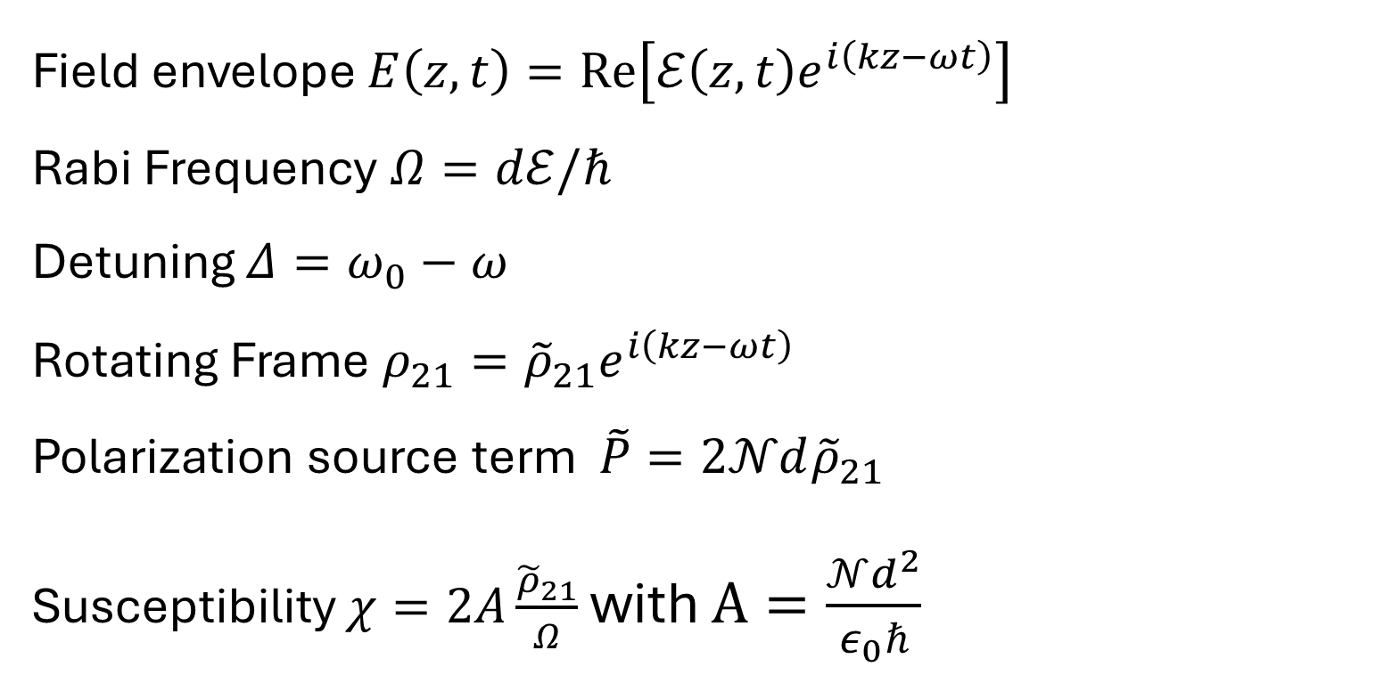
Remember some conventions/results
Field envelope $E\left(z,t\right)=Re\left[ℰ\left(z,t\right)e^{i\left(kz−ωt\right)}\right]$
Rabi Frequency $Ω=dℰ/ℏ$
Detuning $Δ=ω_{0}−ω$
Rotating Frame $ρ_{21}={\tilde{ρ}}_{21}e^{i\left(kz−ωt\right)}$
Polarization source term $\tilde{P}=2𝒩d{\tilde{ρ}}_{21}$
Susceptibility $χ=2A\frac{{\tilde{ρ}}_{21}}{Ω}$ with $A=\frac{𝒩d^{2}}{ε_{0}ℏ}$

Slide 4
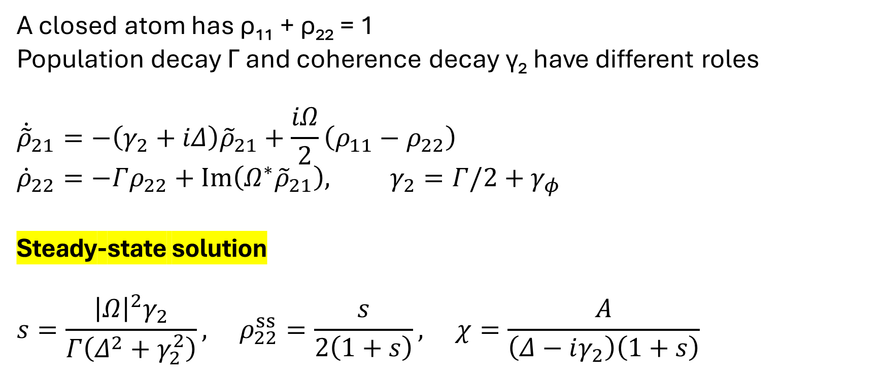
Two level atom response
A closed atom has ρ₁₁ + ρ₂₂ = 1
Population decay Γ and coherence decay γ₂ have different roles
$${\dot{\tilde{ρ}}}_{21}=−\left(γ_{2}+iΔ\right){\tilde{ρ}}_{21}+\frac{iΩ}{2}\left(ρ_{11}−ρ_{22}\right)$$
$${\dot{ρ}}_{22}=−Γρ_{22}+Im\left(Ω^{∗}{\tilde{ρ}}_{21}\right), γ_{2}=Γ/2+γ_{φ}$$
Steady-state solution
$$s=\frac{{\left|Ω\right|}^{2}γ_{2}}{Γ\left(Δ^{2}+γ_{2}^{2}\right)}, ρ_{22}^{ss}=\frac{s}{2\left(1+s\right)}, χ=\frac{A}{\left(Δ−iγ_{2}\right)\left(1+s\right)}$$

Slide 5
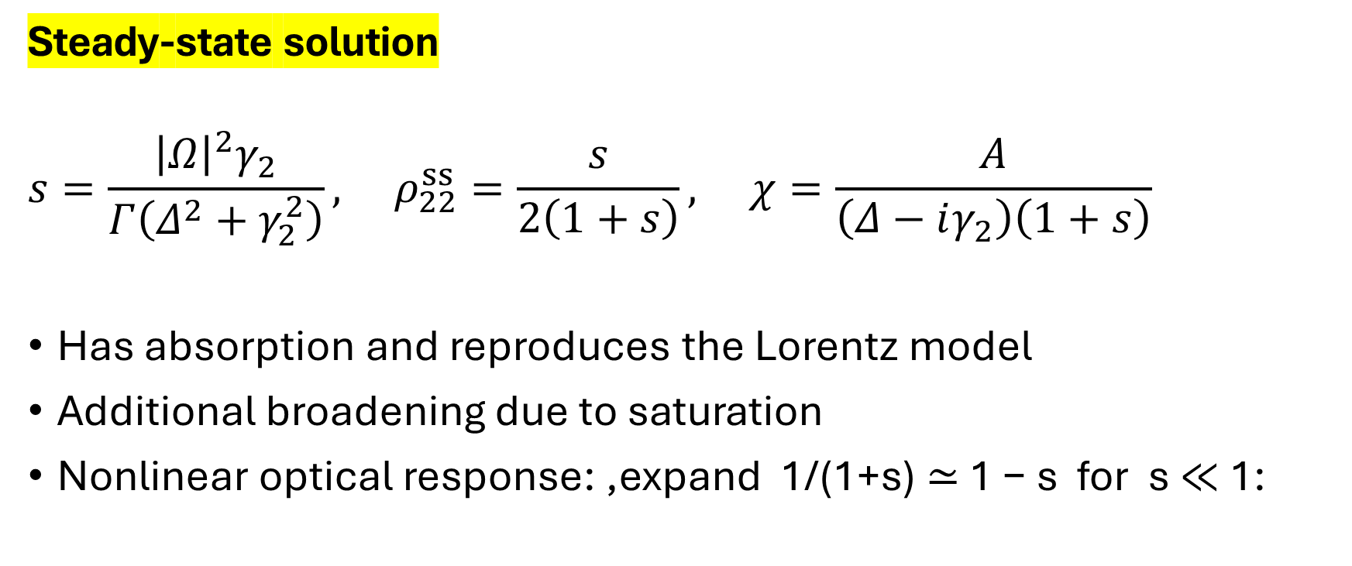
Two level atom response
Steady-state solution
$$s=\frac{{\left|Ω\right|}^{2}γ_{2}}{Γ\left(Δ^{2}+γ_{2}^{2}\right)}, ρ_{22}^{ss}=\frac{s}{2\left(1+s\right)}, χ=\frac{A}{\left(Δ−iγ_{2}\right)\left(1+s\right)}$$
Has absorption and reproduces the Lorentz model
Additional broadening due to saturation
Nonlinear optical response: ,expand 1/(1+s) ≃ 1 − s for s ≪ 1:

Slide 6
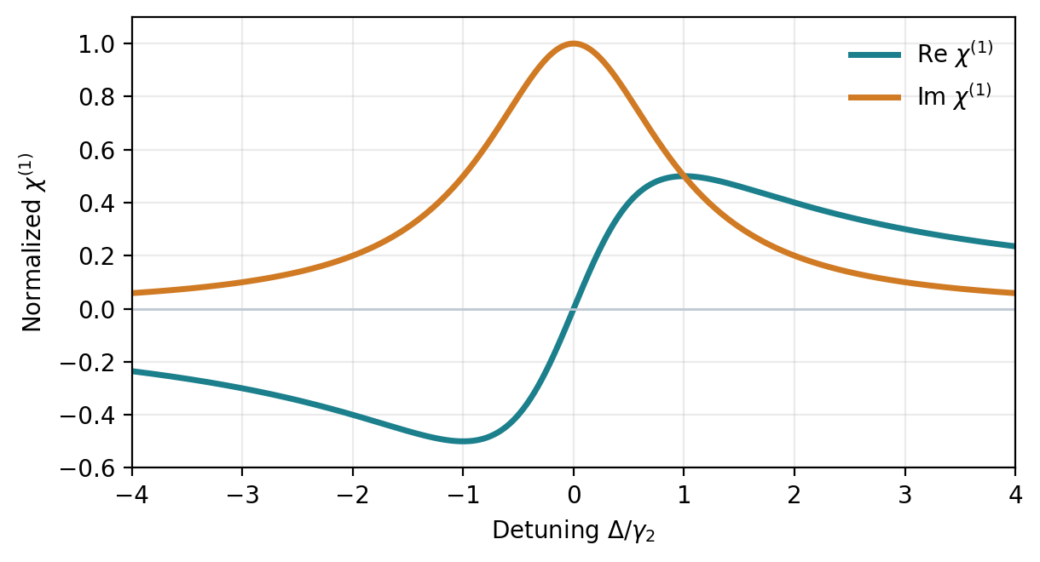
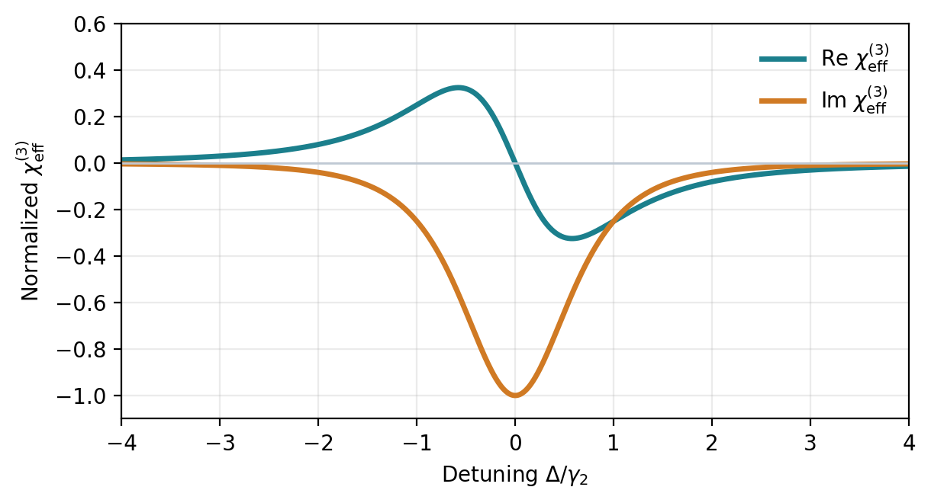
Two level atom response
Steady-state solution
Great playground for nonlinear optics

Slide 7
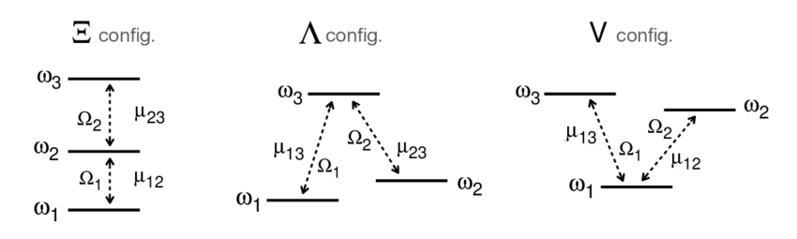
Three-level atoms
There are 3 configurations
The most interesting is the Lambda model

Slide 8
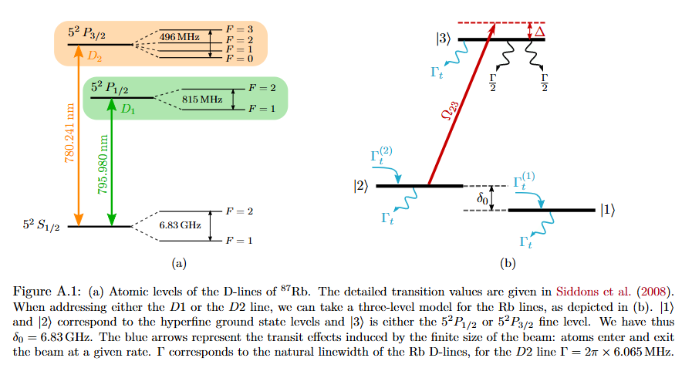
Three-level atoms

Slide 9
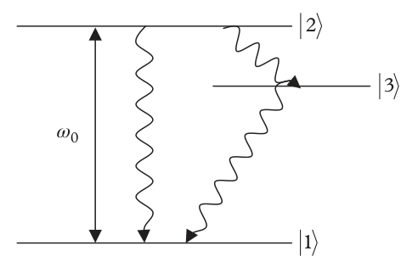
Three-level atoms: Steady-state
EMF drives |1⟩ ↔ |2⟩
Hamiltonian
State |3⟩ receives population by decay.
Consider only decays, no dephasing
Γ₂₁: |2⟩ → |1⟩
Γ₂₃: |2⟩ → |3⟩
Γ₃₁: |3⟩ → |1⟩

Slide 10
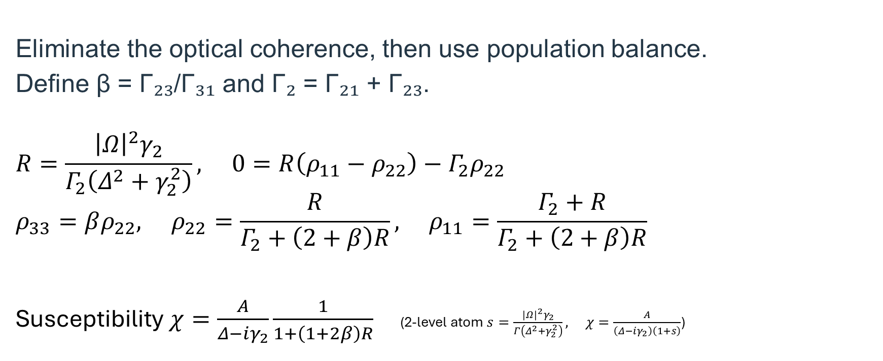
Three-level atoms: Steady-state
Eliminate the optical coherence, then use population balance.
Define β = Γ₂₃/Γ₃₁ and Γ₂ = Γ₂₁ + Γ₂₃.
$$R=\frac{{\left|Ω\right|}^{2}γ_{2}}{Γ_{2}\left(Δ^{2}+γ_{2}^{2}\right)}, 0=R\left(ρ_{11}−ρ_{22}\right)−Γ_{2}ρ_{22}$$
$$ρ_{33}=βρ_{22}, ρ_{22}=\frac{R}{Γ_{2}+\left(2+β\right)R}, ρ_{11}=\frac{Γ_{2}+R}{Γ_{2}+\left(2+β\right)R}$$
Susceptibility $χ=\frac{A}{Δ−iγ_{2}}\frac{1}{1+\left(1+2β\right)R}$ (2-level atom $s=\frac{{\left|Ω\right|}^{2}γ_{2}}{Γ\left(Δ^{2}+γ_{2}^{2}\right)}, χ=\frac{A}{\left(Δ−iγ_{2}\right)\left(1+s\right)}$)

Slide 11
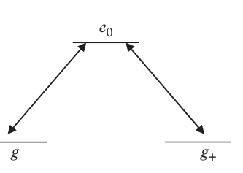
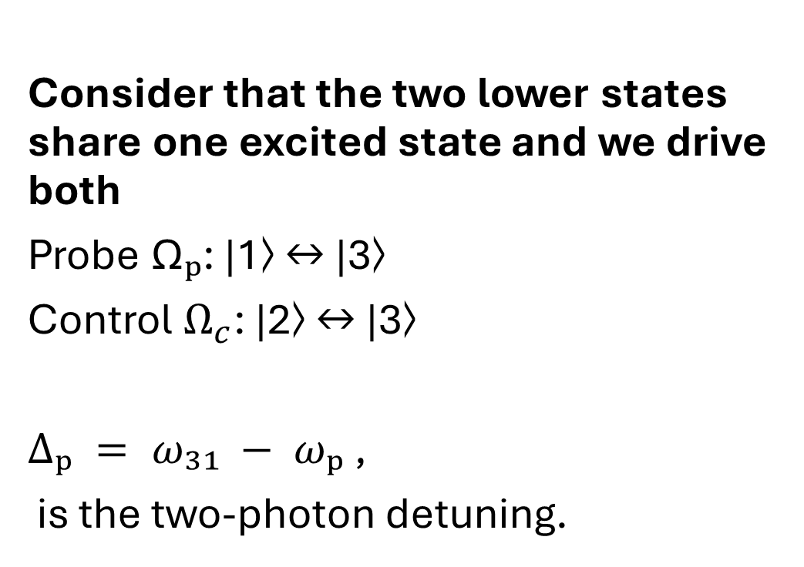
Three-level atoms: Steady-state
Consider that the two lower states share one excited state and we drive both
Probe Ωₚ: |1⟩ ↔ |3⟩
Control $Ω_{c}$: |2⟩ ↔ |3⟩
$Δₚ = ω₃₁ − ωₚ$ ,
is the two-photon detuning.

Slide 12
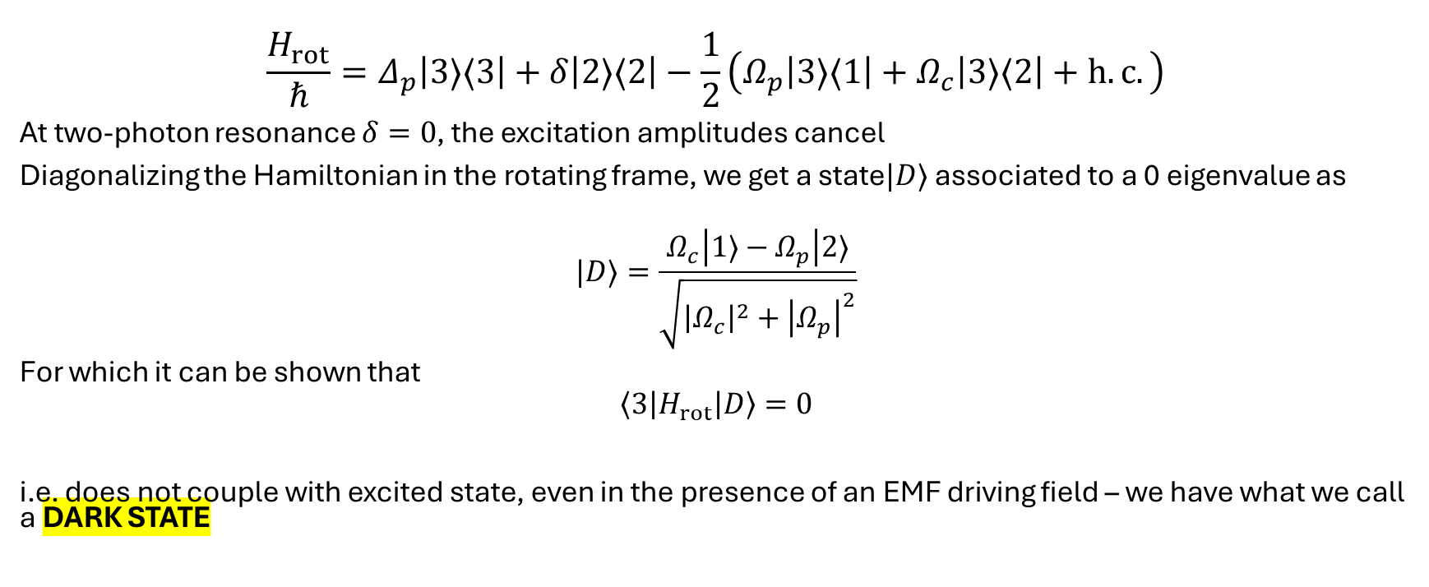
Three-level atoms: Steady-state
$$\frac{H_{rot}}{ℏ}=Δ_{p}\left|3⟩⟨3\right|+δ\left|2⟩⟨2\right|−\frac{1}{2}\left(Ω_{p}\left|3⟩⟨1\right|+Ω_{c}\left|3⟩⟨2\right|+h.c.\right)$$
At two-photon resonance $δ=0$, the excitation amplitudes cancel
Diagonalizing the Hamiltonian in the rotating frame, we get a state$|D⟩$ associated to a 0 eigenvalue as
$$|D⟩=\frac{Ω_{c}\left|1⟩−Ω_{p}\right|2⟩}{\sqrt{{\left|Ω_{c}\right|}^{2}+{\left|Ω_{p}\right|}^{2}}}$$
For which it can be shown that
$$\left\langle 3\left|H_{rot}\right|D\right\rangle =0$$
i.e. does not couple with excited state, even in the presence of an EMF driving field – we have what we call a DARK STATE

Slide 13
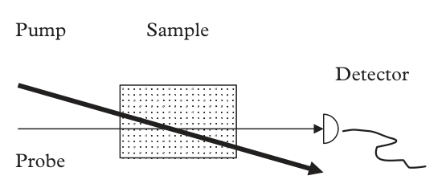
Perturbative approach to get a steady state solution
Sometimes the resulting equation system from master equation is hard to solve in analytical manner and even impossible
In this case we need a perturbative approach, which is valid under a regime that we call a pump-probe experiment:
A strong pump prepares the atomic steady state.
A weak probe measures its differential optical response.
Scan probe frequency, or delay a probe pulse after excitation.

Slide 14
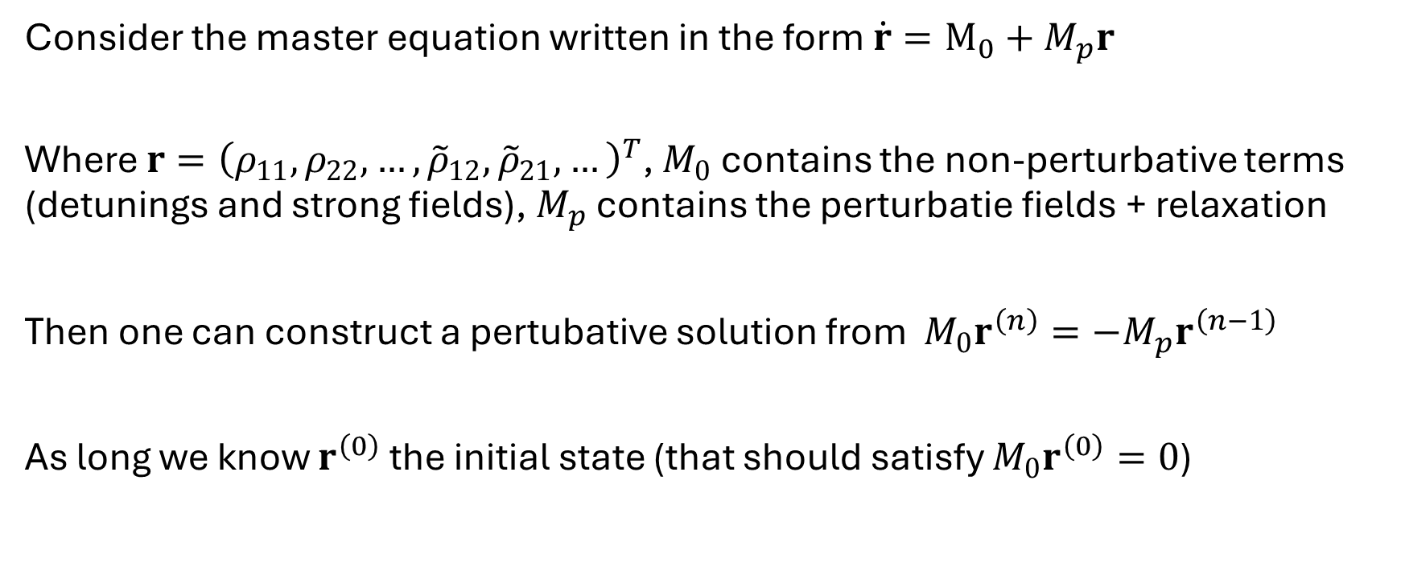
Perturbative approach to get a steady state solution
Consider the master equation written in the form $\dot{r}=M_{0}+M_{p}r$
Where $r={\left(ρ_{11},ρ_{22},…,{\tilde{ρ}}_{12},{\tilde{ρ}}_{21},…\right)}^{T}$, $M_{0}$ contains the non-perturbative terms (detunings and strong fields), $M_{p}$ contains the perturbatie fields + relaxation
Then one can construct a pertubative solution from $M_{0}r^{\left(n\right)}=−M_{p}r^{\left(n−1\right)}$
As long we know $r^{\left(0\right)}$ the initial state (that should satisfy $M_{0}r^{\left(0\right)}=0$)

Slide 15
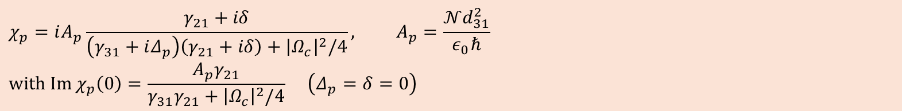
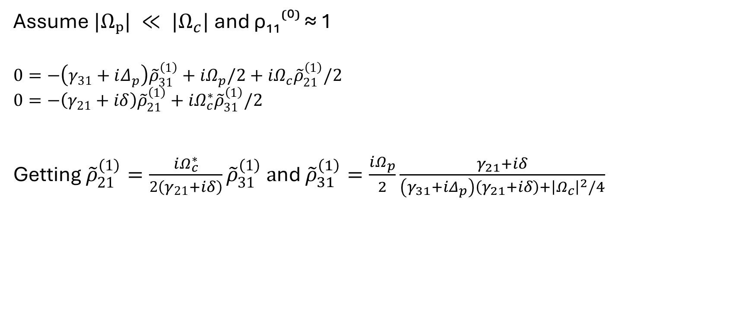
Example: 3-level lambda atom
Assume $|Ωₚ| ≪ |Ω_{c}|$and ρ₁₁⁽⁰⁾ ≈ 1
$$0=−\left(γ_{31}+iΔ_{p}\right){\tilde{ρ}}_{31}^{\left(1\right)}+iΩ_{p}/2+iΩ_{c}{\tilde{ρ}}_{21}^{\left(1\right)}/2$$
$$0=−\left(γ_{21}+iδ\right){\tilde{ρ}}_{21}^{\left(1\right)}+iΩ_{c}^{∗}{\tilde{ρ}}_{31}^{\left(1\right)}/2$$
Getting ${\tilde{ρ}}_{21}^{\left(1\right)}=\frac{iΩ_{c}^{∗}}{2\left(γ_{21}+iδ\right)}{\tilde{ρ}}_{31}^{\left(1\right)} a$nd ${\tilde{ρ}}_{31}^{\left(1\right)}=\frac{iΩ_{p}}{2}\frac{γ_{21}+iδ}{\left(γ_{31}+iΔ_{p}\right)\left(γ_{21}+iδ\right)+{\left|Ω_{c}\right|}^{2}/4}$
$$χ_{p}=iA_{p}\frac{γ_{21}+iδ}{\left(γ_{31}+iΔ_{p}\right)\left(γ_{21}+iδ\right)+{\left|Ω_{c}\right|}^{2}/4}, A_{p}=\frac{𝒩d_{31}^{2}}{ε_{0}ℏ}$$
$$with Im χ_{p}\left(0\right)=\frac{A_{p}γ_{21}}{γ_{31}γ_{21}+{\left|Ω_{c}\right|}^{2}/4} \left(Δ_{p}=δ=0\right)$$

Slide 16
Electromagnetic Induced Transparency
Control on resonance: Δc = 0, so δ = Δₚ.
Ωc/γ₃₁ = 0.8 and γ₂₁/γ₃₁ = 0.02.
The narrow absorption dip accompanies steep dispersion

Slide 17
Electromagnetic Induced Transparency
Control on resonance: Δc = 0, so δ = Δₚ.
Ωc/γ₃₁ = 0.8 and γ₂₁/γ₃₁ = 0.02.
The narrow absorption dip accompanies steep dispersion – Slow light
Nonlinear Response also possible

Slide 18
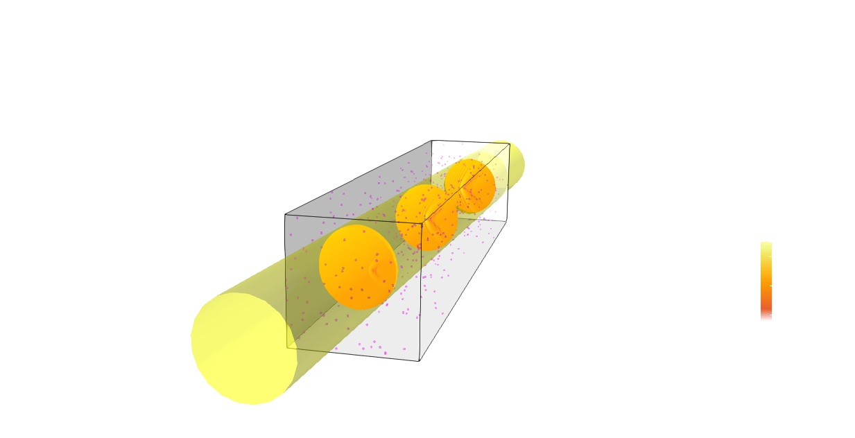
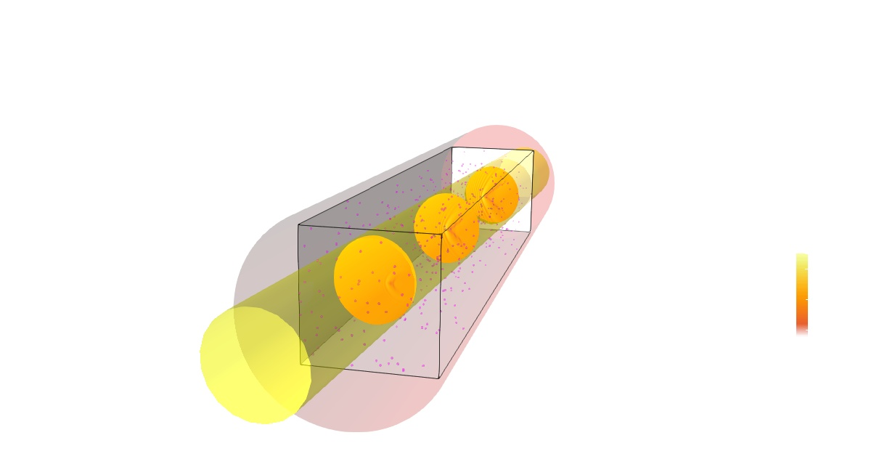
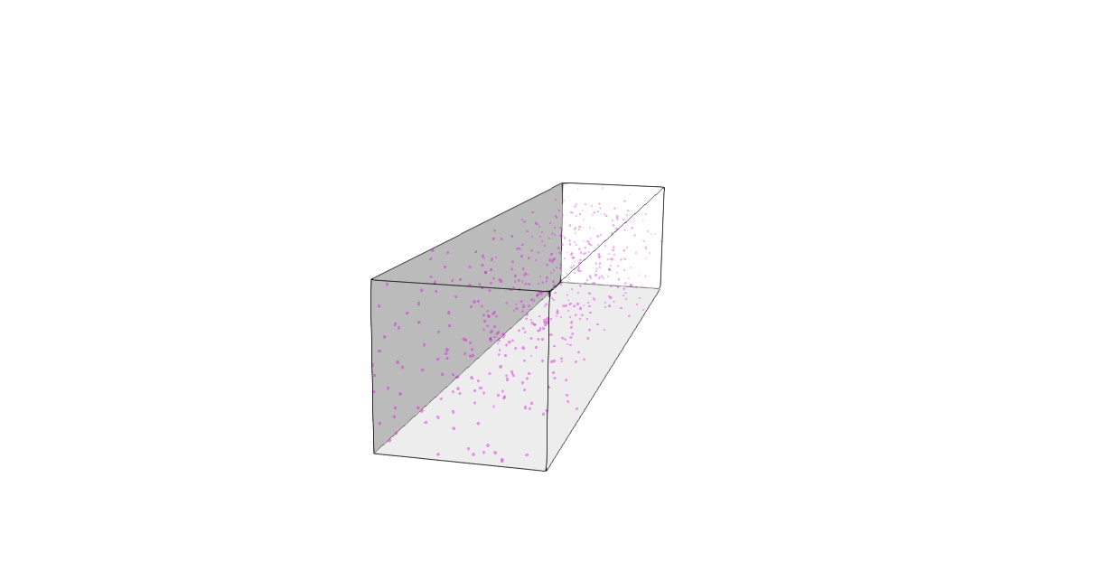

Optical response of a 4-level atomic system
z
4-level system ($N$-type)

Slide 19
Optical response of a 4-level atomic system
z
4-level system ($N$-type)

Slide 20
Optical response of a 4-level atomic system
z
4-level system ($N$-type)

Slide 21
Optical response of a 4-level atomic system
Paraxial approximation of the wave equation

Slide 22
Optical response of a 4-level atomic system
Paraxial approximation of the wave equation
Susceptibility

Slide 23
Optical response of a 4-level atomic system
Paraxial approximation of the wave equation
Susceptibility
Solve the Bloch equation system for steady-state

Slide 24
Local optical response
Electromagnetic induced transparency regime

Slide 25
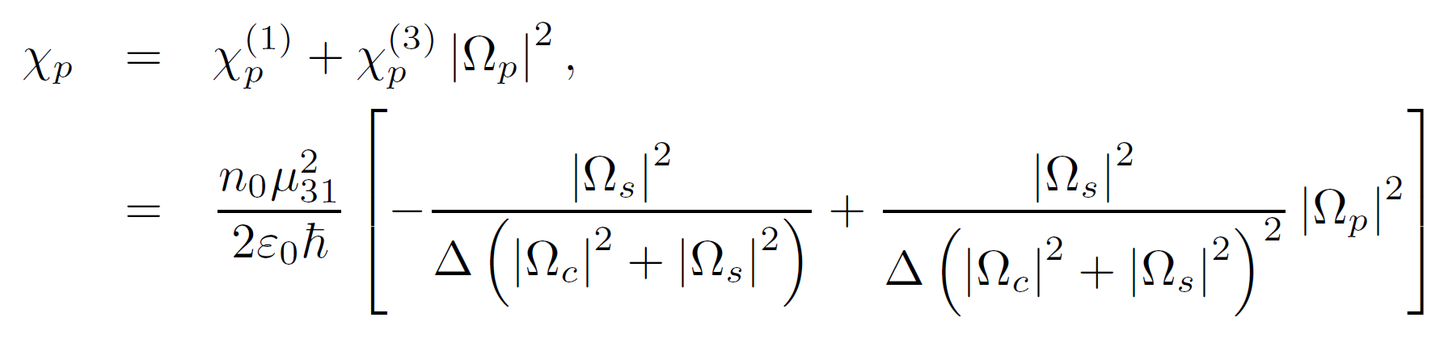
Local optical response
Electromagnetic induced transparency regime
Linear and nonlinear susceptibility

Slide 26
Local optical response
Electromagnetic induced transparency regime
Linear and nonlinear susceptibility

Slide 27
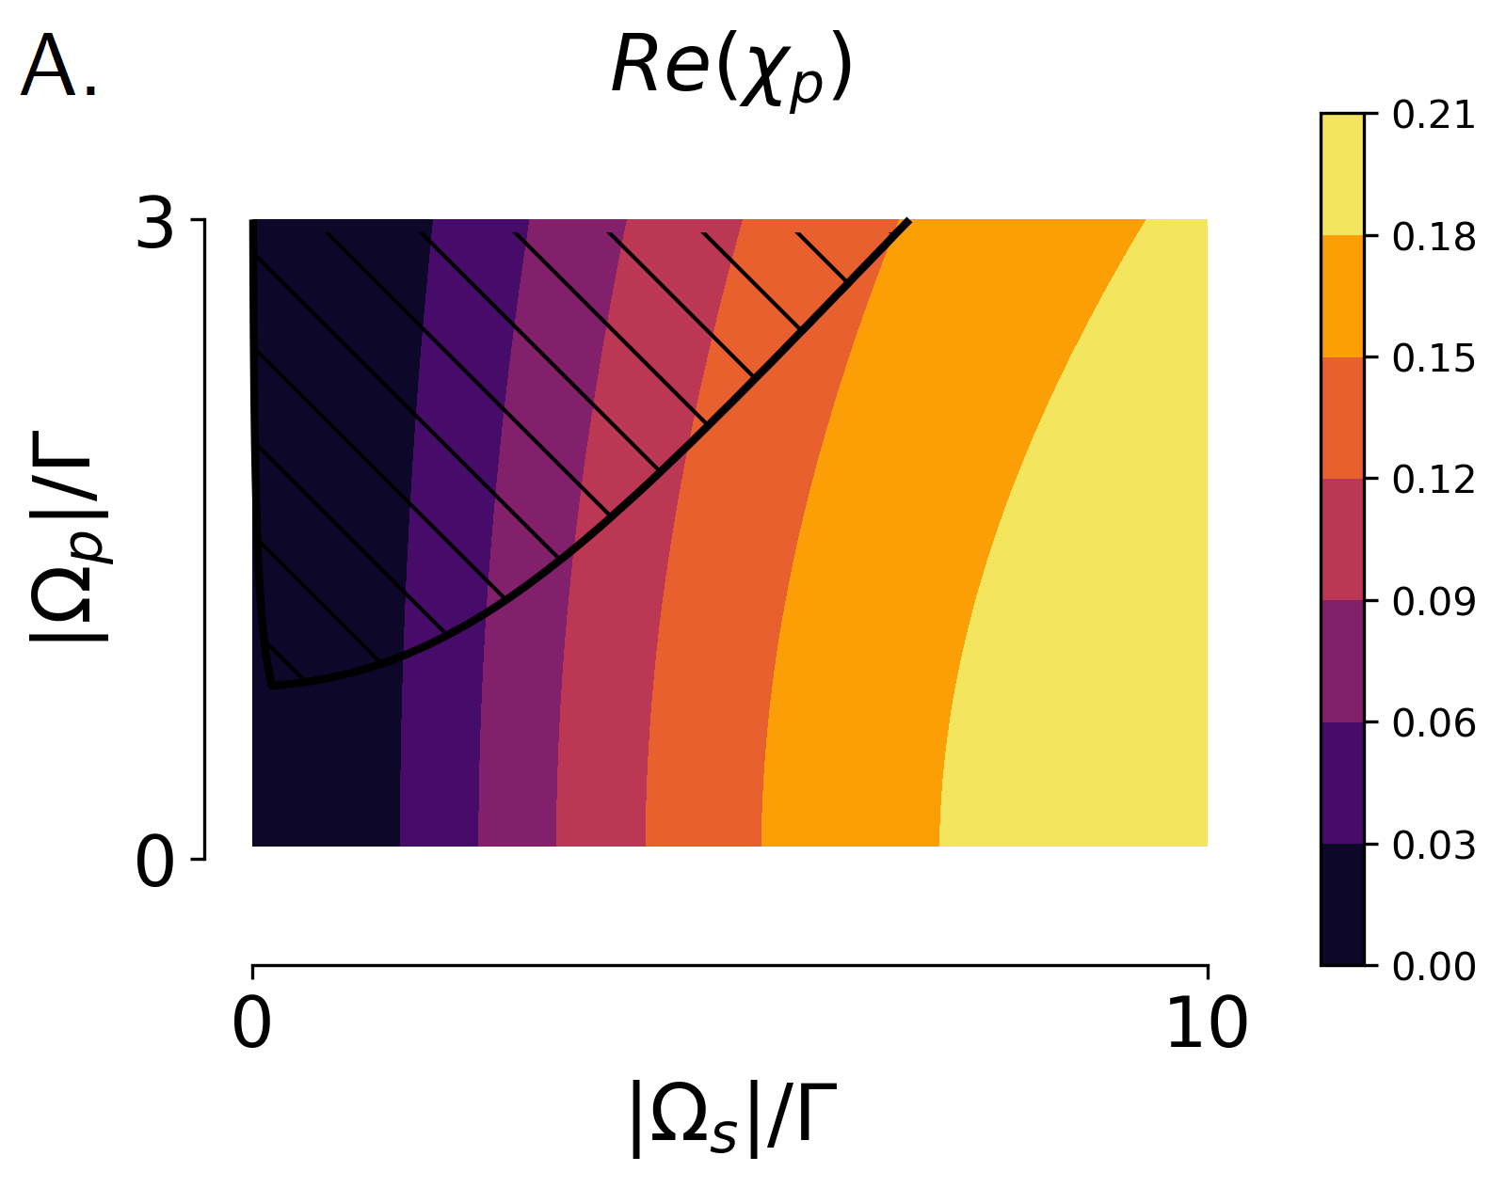
Local optical response
Highly-tunable local
optical response

Slide 28
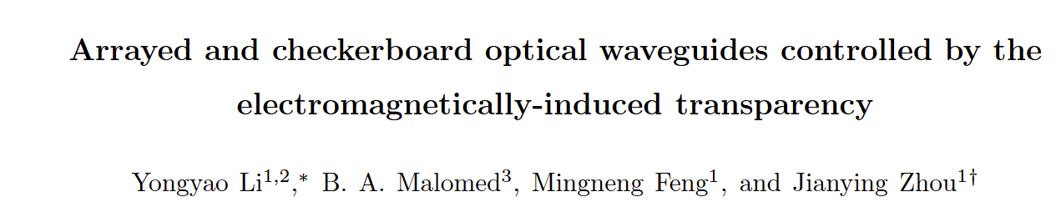
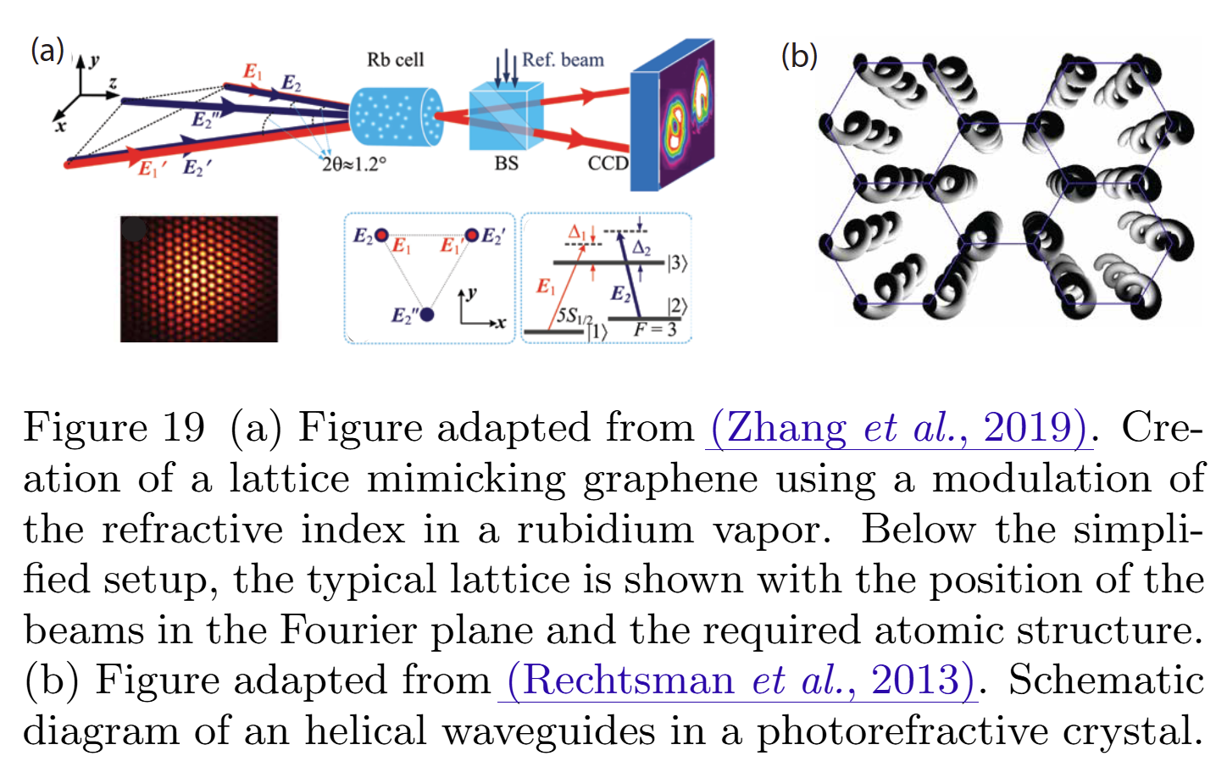
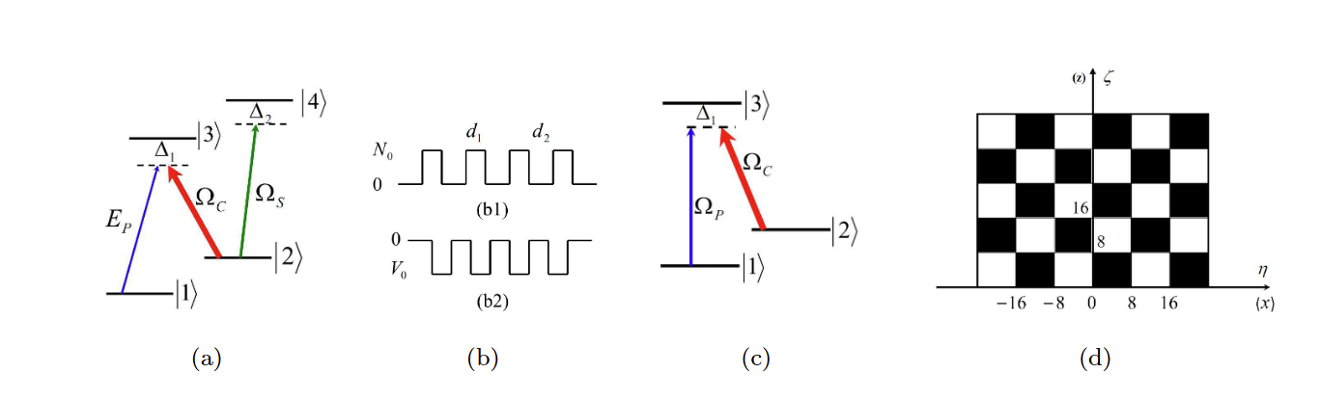
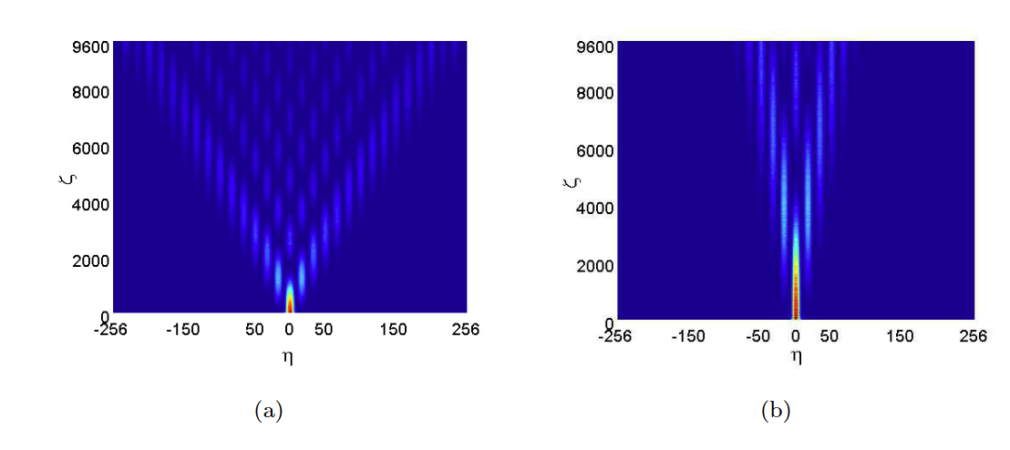
Local optical response

Slide 29
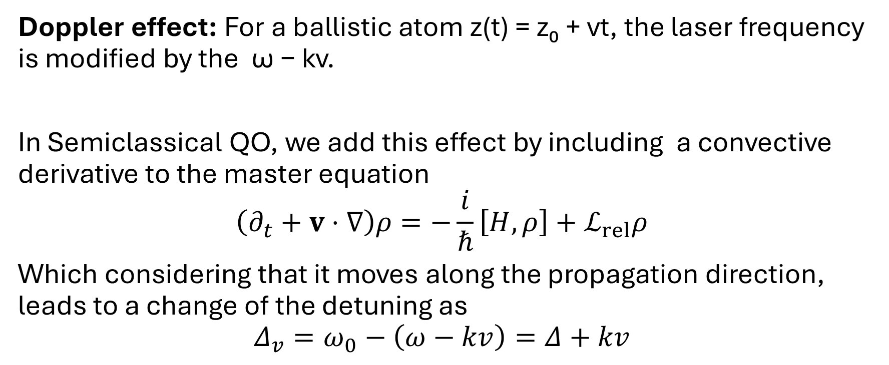
Moving atoms
Doppler effect: For a ballistic atom z(t) = z₀ + vt, the laser frequency is modified by the ω − kv.
In Semiclassical QO, we add this effect by including a convective derivative to the master equation
$$\left(∂_{t}+v⋅∇\right)ρ=−\frac{i}{ℏ}\left[H,ρ\right]+ℒ_{rel}ρ$$
Which considering that it moves along the propagation direction, leads to a change of the detuning as
$$Δ_{v}=ω_{0}−\left(ω−kv\right)=Δ+kv$$

Slide 30
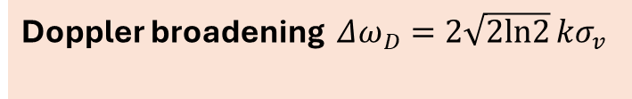
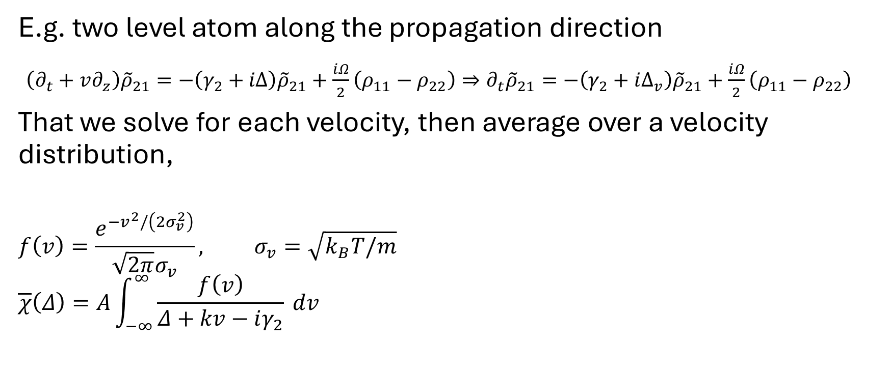
Moving atoms
E.g. two level atom along the propagation direction
$\left(∂_{t}+v∂_{z}\right){\tilde{ρ}}_{21}=−\left(γ_{2}+iΔ\right){\tilde{ρ}}_{21}+\frac{iΩ}{2}\left(ρ_{11}−ρ_{22}\right)⇒∂_{t}{\tilde{ρ}}_{21}=−\left(γ_{2}+iΔ_{v}\right){\tilde{ρ}}_{21}+\frac{iΩ}{2}\left(ρ_{11}−ρ_{22}\right)$
That we solve for each velocity, then average over a velocity distribution,
$$f\left(v\right)=\frac{e^{−v^{2}/\left(2σ_{v}^{2}\right)}}{\sqrt{2π}σ_{v}}, σ_{v}=\sqrt{k_{B}T/m}$$
$$\overline{χ}\left(Δ\right)=A\int_{−∞}^{∞}{\frac{f\left(v\right)}{Δ+kv−iγ_{2}}} dv$$
Doppler broadening $Δω_{D}=2\sqrt{2ln2} kσ_{v}$

Slide 31
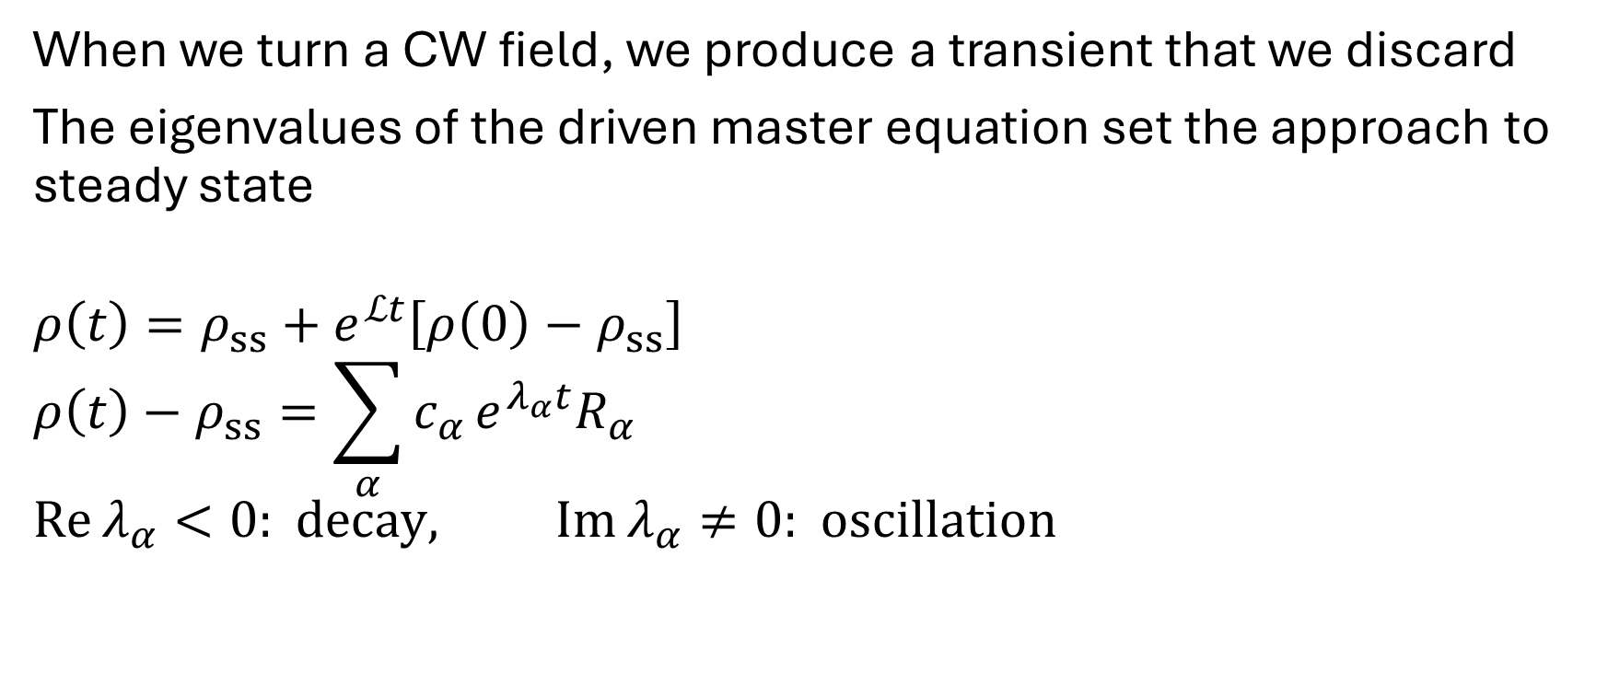
Transient Response
When we turn a CW field, we produce a transient that we discard
The eigenvalues of the driven master equation set the approach to steady state
$$ρ\left(t\right)=ρ_{ss}+e^{ℒt}\left[ρ\left(0\right)−ρ_{ss}\right]$$
$$ρ\left(t\right)−ρ_{ss}=\sum_{α}^{​}{c_{α}}e^{λ_{α}t}R_{α}$$
$$Re λ_{α}<0: decay, Im λ_{α}≠0: oscillation$$

Slide 32
E.g. Damped Rabi oscillations

Slide 33
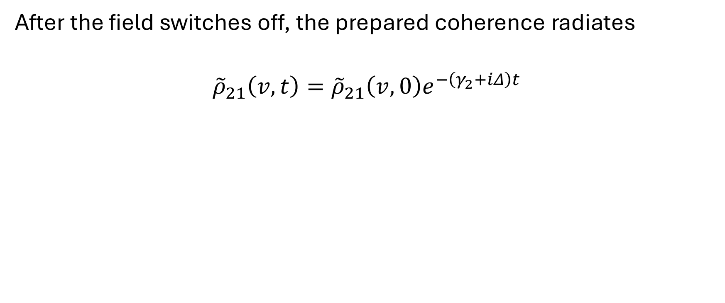
E.g. Free Induction decay
After the field switches off, the prepared coherence radiates
$${\tilde{ρ}}_{21}\left(v,t\right)={\tilde{ρ}}_{21}\left(v,0\right)e^{−\left(γ_{2}+iΔ\right)t}$$

Slide 34
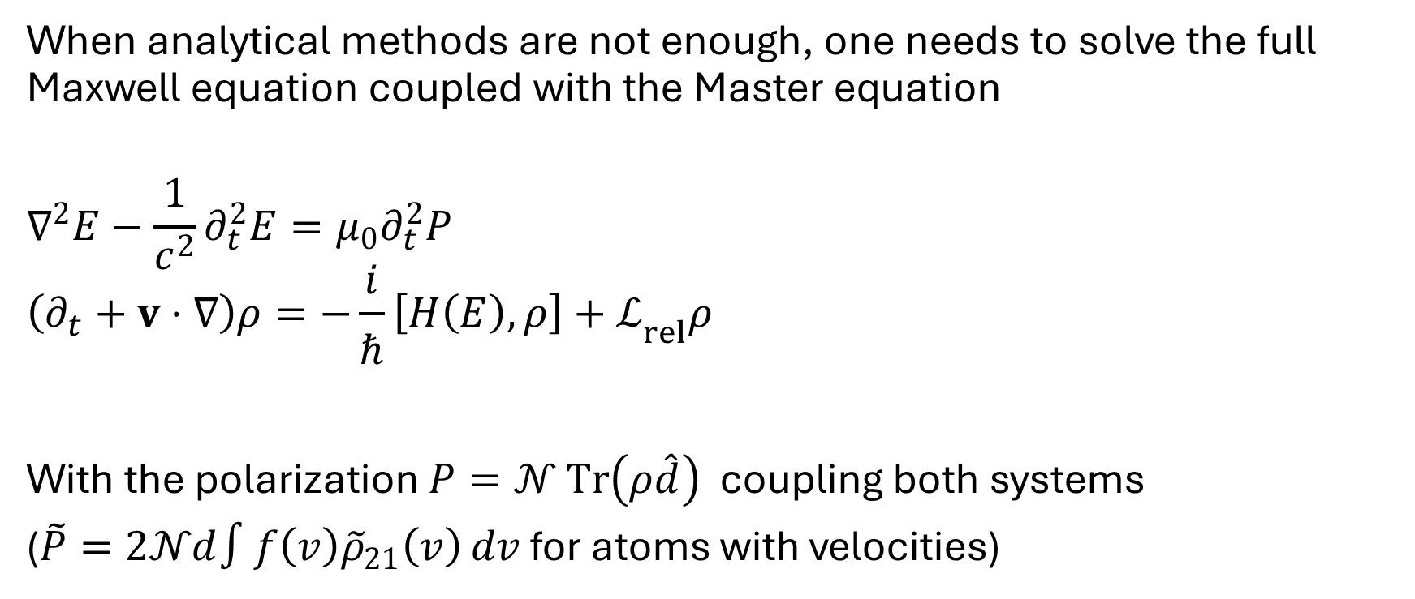
Maxwell-Bloch Equations
When analytical methods are not enough, one needs to solve the full Maxwell equation coupled with the Master equation
$$∇^{2}E−\frac{1}{c^{2}}∂_{t}^{2}E=μ_{0}∂_{t}^{2}P$$
$$\left(∂_{t}+v⋅∇\right)ρ=−\frac{i}{ℏ}\left[H\left(E\right),ρ\right]+ℒ_{rel}ρ$$
With the polarization $P=𝒩 Tr\left(ρ\hat{d}\right)$ coupling both systems
($\tilde{P}=2𝒩d∫f\left(v\right){\tilde{ρ}}_{21}\left(v\right) dv$ for atoms with velocities)

